Slide 1
Automated Searching for Differential Characteristics in SHA-2
Mitchell Grout
Supervised by Dr. Ryan Ko and Aleksey Ladur

Slide 2
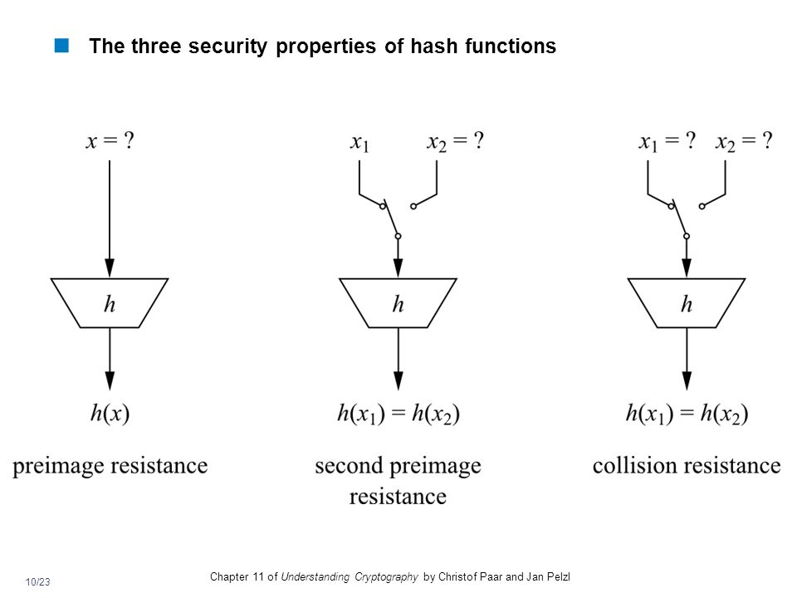
Background
SHA-2: Family of cryptographic hash functions (FIPS180-2, NSA)
Preimage, Second Preimage, and Collision Resistances
Used for cryptocurrencies, file integrity, verifying passwords

Slide 3


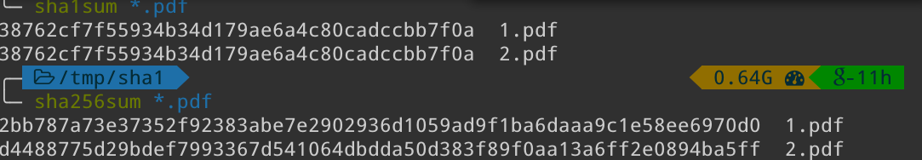
Motivation
Broken hash functions are vectors for attacks, especially MITM attacks
SHA-0, SHA-1 already broken
SHA-2 should be deprecated before it can be used maliciously

Slide 4
Differential Cryptanalysis
Determine how XOR differences change through components
Propagation determines what output differences occur for given input differences
General formula is f(x) ⊕ f(x ⊕ Δ) for all possible x
For the simplest SHA-256 component, 2¹²⁸ computations
At 10¹² computations per second, would take over 10⁸ times the age of the universe to complete
Random sampling necessary

Slide 5
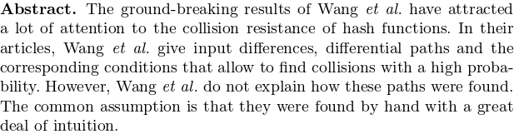
Problem Outline
A differential attack requires an input difference Δ₀
Unclear in many papers how the value is found
Can we guess-and-check values?
Can we improve known values?
Project goal: Can optimization algorithms be used to find Δ₀

Slide 6
Our Novel Method
Implemented a reduced version of SHA-256 in C, MAW32
Allows testing of ideas quickly
Designed space-efficient propagation algorithms
Designed a suite of tools to generate and test results
Three methods to generate data: - Random - Genetic - Hybrid: Combination of genetic and random
 | SHA-256 | MAW32
Block Size (bits) | 512 | 64
Digest Size (bits) | 256 | 32
Rounds | 64 | 16

Slide 7
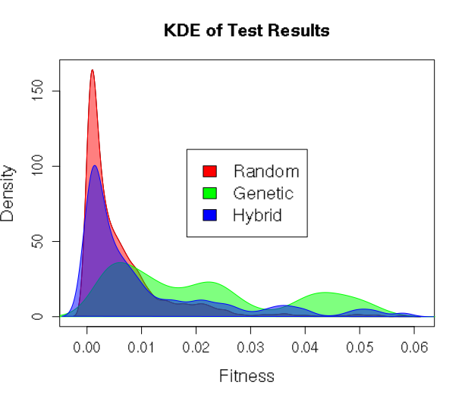
Evaluation
Ran three simulations over 24 hours
Input differences for 8 rounds of MAW32
Genetic & hybrid more effective than random, p = 2.2x10⁻¹⁶ < 0.05
Technique | Total | Unique | Mean Fitness
Random | 5,725 | 5,435 | 0.00634
Genetic | 454,186 | 1,567 | 0.02108
Hybrid | 94,241 | 6,766 | 0.01069

Slide 8
Evaluation
Pure random search very slow, results are poor
Genetic runs very quickly, produces good results
Converges very rapidly
Hybrid approach helps prevent convergence
Finding initial pool still relies on random search

Slide 9
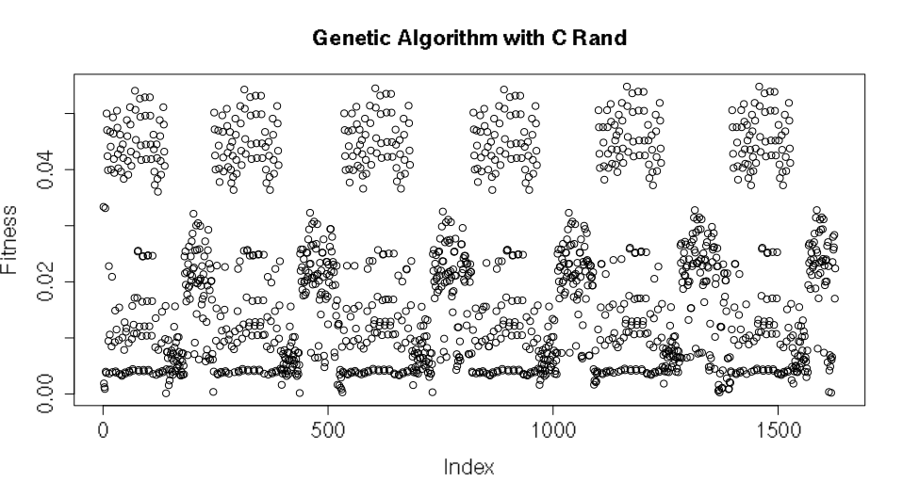

Challenges
Time constraints
Imperfect heuristic
C versus C++
Hardware constraints
Hardware failure

Slide 10
Current Research
Most papers do not fully specify how Δ₀ is found
Choice of Δ₀ important for an attack to be successful
Better knowledge of finding these values is beneficial
Optimization algorithms appear to be promising

Slide 11
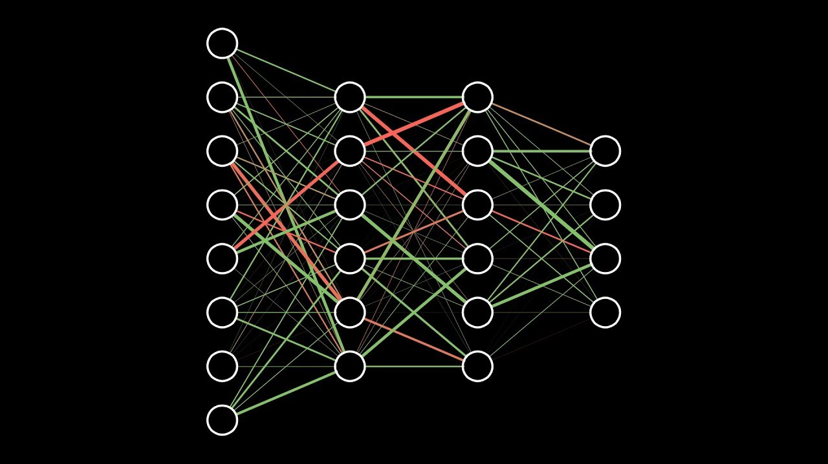

Future Work
Consider other optimization algorithms
Parallelization and distribution
Find more effective ways to propagate input differences with limited resources
Early bailout on dead-end propagations

Slide 12
Questions
[1] – Paar, C. and J. Pelzl, Understanding Cryptography. 2010.
[2] - https://www.mscs.dal.ca/~selinger/md5collision/
[3] - https://shattered.io/
[4] - Schläffer, M. and E. Oswald. Searching for Differential Paths in MD4. 2006

